Slide 1




Environmental influence on the Atlantic salmon epigenome during sea lice infestation
Shelly Trigg, Ph.D.
Steven Roberts Lab
School of Aquatic and Fishery Sciences
University of Washington
In collaboration with Cristian Gallardo-Escárate, Valentina Valenzuela-Muñoz, and Gustavo Núñez-Acuña
Universidad de Concepción, Chile
Notes:
Hi Everyone,
I'm happy to be here and excited to share this new project which is my first involving salmonid biology. My background is in functional genomics in plants. And I'm currently a post doc in Steven Roberts lab at UW studying molecular physiology with omics tools. This project is a collaboration with Cristian Gallardo Escarate's lab en Chile . So I'd like to thank my lab and collaborators

Slide 2
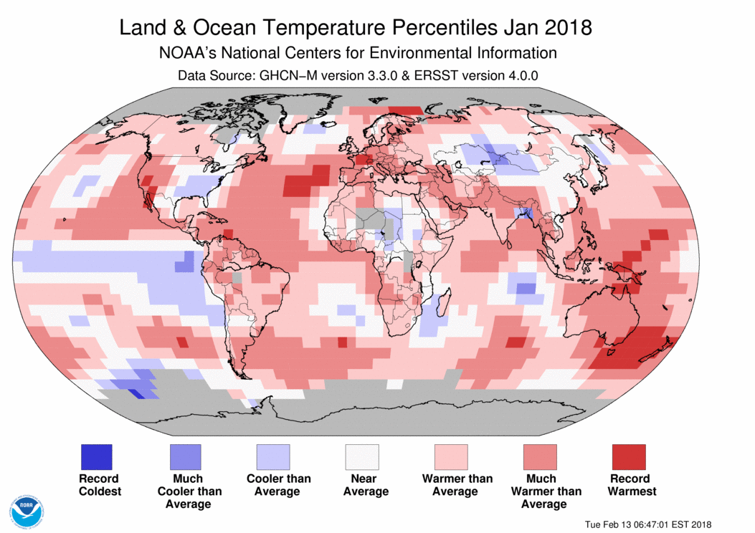
Environmental threats to Salmon
Ocean change
temperature impacts salmon physiology
Some studies show heat tolerance BUT at a cost
Anttila et al (2014) Nat Comm, Tromp et al. (2018) Aquaculture, Nuez-Ortin et al. (2018) BMC Genomics
Notes:
Salmon are faced with environmental challenges in the face of climate change. For instance ocean
Changing environmental conditions are a threat to Salmon. Stress and immunity (https://journals.plos.org/plosone/article?id=10.1371/journal.pone.0054656)

Slide 3
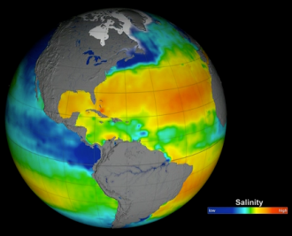
Environmental threats to Salmon
Ocean change
temperature impacts salmon physiology
Some studies show heat tolerance BUT at a cost
Anttila et al (2014) Nat Comm, Tromp et al. (2018) Aquaculture, Nuez-Ortin et al. (2018) BMC Genomics
salinity
Brown et al. (2018) J. Fish Biol.
https://science.nasa.gov/earth-science/oceanography/physical-ocean/salinity
Notes:
Salmon are faced with environmental challenges in the face of climate change. For instance ocean Changing environmental conditions are a threat to Salmon. Stress and immunity (https://journals.plos.org/plosone/article?id=10.1371/journal.pone.0054656)
Changing environmental conditions are a threat to Salmon. Stress and immunity (https://journals.plos.org/plosone/article?id=10.1371/journal.pone.0054656)

Slide 4
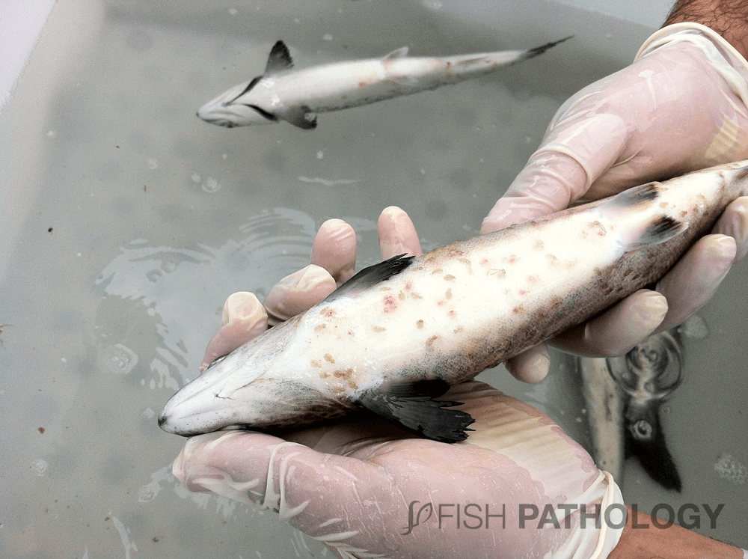
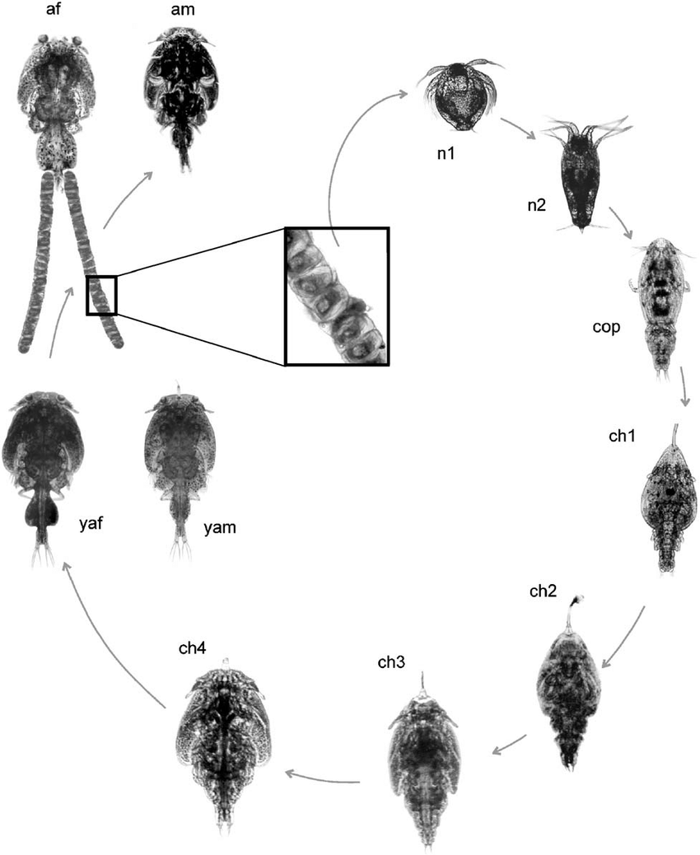
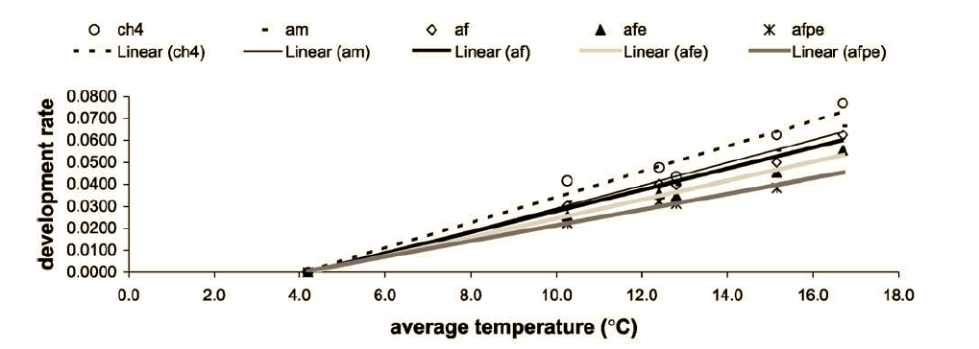
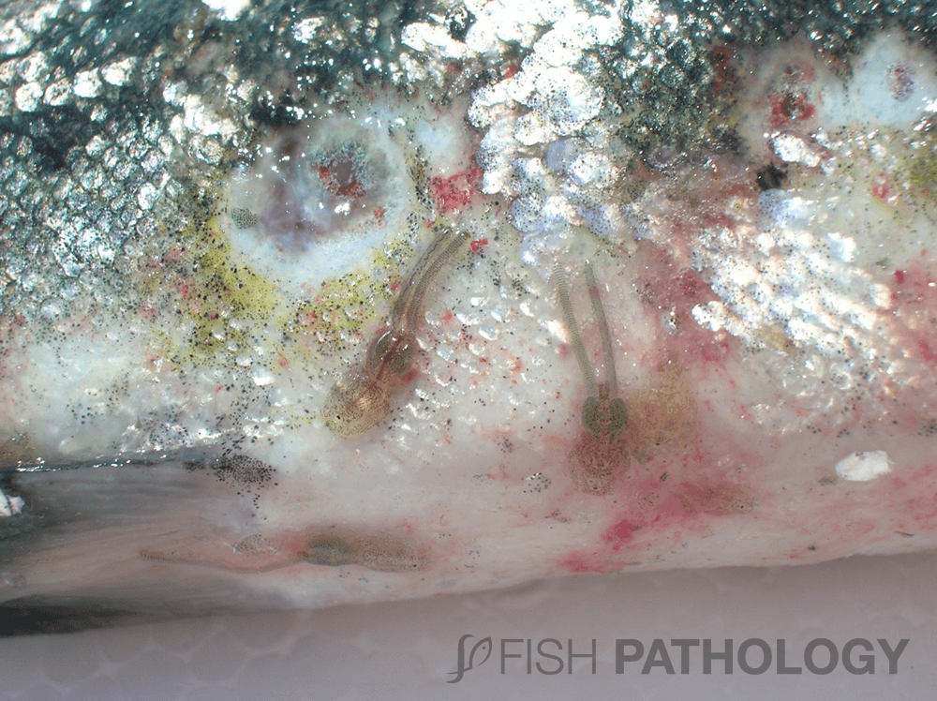
Environmental conditions can exacerbate sea lice infestation
Temperature affects development
González et al (2003) Aquaculture

Slide 5
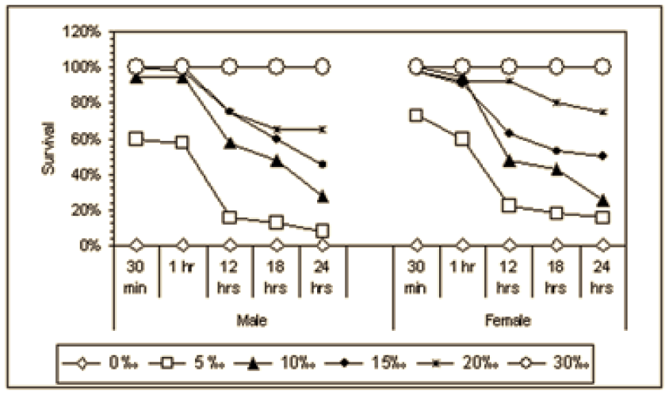
Environmental conditions can exacerbate sea lice infestation
Temperature affects development
González et al (2003) Aquaculture
Salinity affects survival
Bravo et al (2008) Bulletin of the European Association of Fish Pathologists
Notes:
a problem for industry where infestation is already exacerbated by crowding

Slide 6
How do temperature and salinity affect salmon response to sea lice?
Notes:
In planning for the future

Slide 7
How do temperature and salinity affect salmon response to sea lice?
Methylation is a good way to measure wide-spread change
Epigenetic marks can be directly influenced by the environment
They mediate phenotypic response through gene regulation
Notes:
In planning for the future

Slide 8
How do temperature and salinity affect salmon response to sea lice?
Methylation is a good way to measure wide-spread change
Epigenetic marks can be directly influenced by the environment
They mediate phenotypic response through gene regulation
Do salmon methylomes change in response to environment during sea lice infestation?
How might these methylation changes influence physiology?
Are specific regulatory pathways affected by one factor more than another?
Notes:
In planning for the future

Slide 9


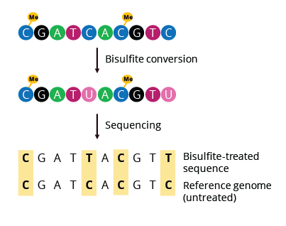
Temperature x salinity experimental set-up
8 fish (S. salar) per tank
Initial load: 35 sea lice (C. rogercresseyi) per fish
4 tanks/treatment
30 days
Reduced-Representation
Bisulfite Sequencing
8°C
skin sections
4 fish/ treatment
16°C
32 psu
26 psu
Normal conditions in Chile = 12 °C and 32 psu
Notes:
6-8 months old, siblings from the same parents.

Slide 10
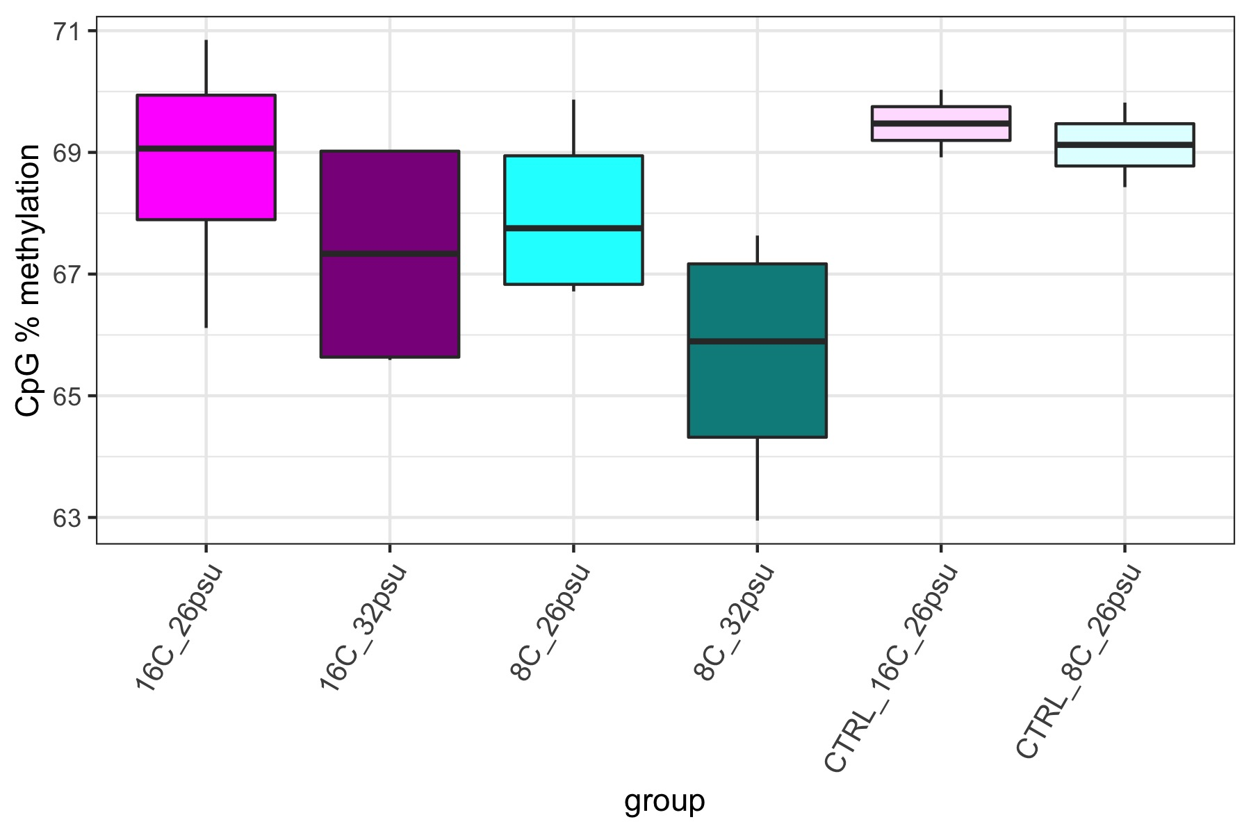
CpG methylation across groups
Total CpGs analyzed: 34,478,010
High salinity groups show a general decrease in overall methylation and greater variance
Notes:
with 5x coverage in ¾ individuals per group

Slide 11
CpG methylation across groups
Total CpGs analyzed: 34,478,010
No sea lice
Notes:
with 5x coverage in ¾ individuals per group

Slide 12
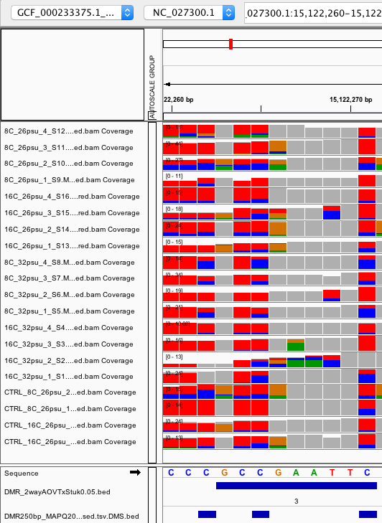
DMR: Differentially methylated region
A 10 - 300bp region containing at least 3 CpGs that are significantly differentially methylated
Notes:
Filtered at 5x coverage within a sample and 3x coverage by individuals within a group

Slide 13
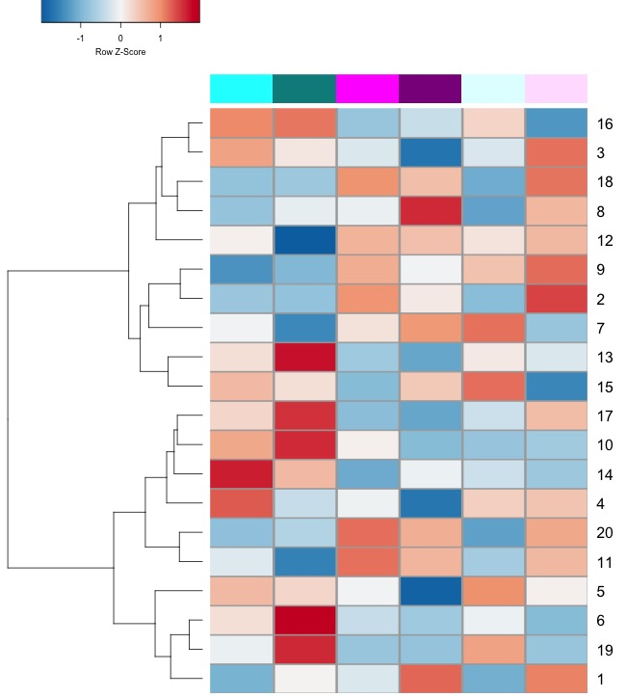
Influence of temperature on methylation
Relative % methylation
8°C
26PSU
8°C
32PSU
16°C
26PSU
16°C
32PSU
8°C
26PSU
16°C
26PSU
Notes:
Significant DMRs

Slide 14
Influence of temperature on methylation
Relative % methylation
8°C
26PSU
8°C
32PSU
16°C
26PSU
16°C
32PSU
8°C
26PSU
16°C
26PSU
Increase in methylation under low temperature (8°C)
Notes:
Significant DMRs

Slide 15
Influence of temperature on methylation
Relative % methylation
SEA LICE
NO SEA LICE
Sea lice-dependent increase in methylation under low temperature (8°C)
8°C
26PSU
8°C
32PSU
16°C
26PSU
16°C
32PSU
8°C
26PSU
16°C
26PSU
Notes:
Maintenance of marks at low temperature make infection less bad?

Slide 16
Influence of temperature on methylation
Relative % methylation
SEA LICE
NO SEA LICE
Sea lice-dependent increase in methylation under low temperature (8°C)
8°C
26PSU
8°C
32PSU
16°C
26PSU
16°C
32PSU
8°C
26PSU
16°C
26PSU
RARA (intron)
HOX activator complex
HOX: specify spatial plan in organ development
Agrin-like (intron)
modulates growth (favors aggregation)
Uncharacterized lncRNA
EGR1
zinc finger that regulates inflammatory response and cell proliferation
Notes:
First Intron methylation correlates with reduced gene expression: https://epigeneticsandchromatin.biomedcentral.com/articles/10.1186/s13072-018-0205-1 (agrin: https://www.sciencedirect.com/science/article/pii/S2211124719308022)

Slide 17
Influence of salinity on methylation
Notes:
Significant DMRs; colored by temperature and shaded by salinity

Slide 18
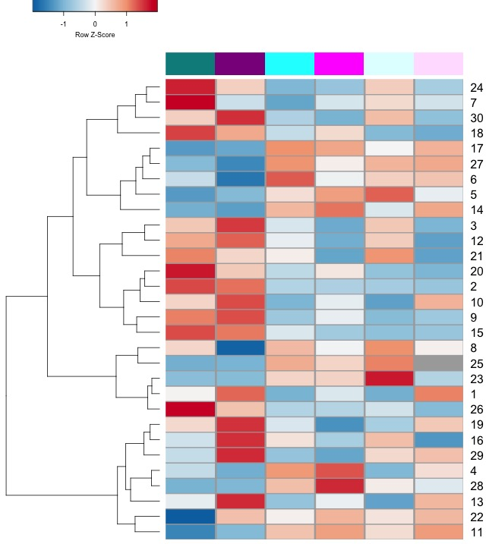
Influence of salinity on methylation
Relative % methylation
SEA LICE
NO SEA LICE
8°C
32PSU
16°C
32PSU
8°C
26PSU
16°C
26PSU
8°C
26PSU
16°C
26PSU
Sea lice-dependent decrease in methylation under low salinity (26psu) and low temp (8°C)
Notes:
Significant DMRs

Slide 19
Influence of salinity on methylation
Relative % methylation
SEA LICE
NO SEA LICE
8°C
32PSU
16°C
32PSU
8°C
26PSU
16°C
26PSU
8°C
26PSU
16°C
26PSU
Sea lice-dependent decrease in methylation under low salinity (26psu) and low temp (8°C)
LBX1
HOX transcription factors
Cell differentiation, spatial specificity
HOXC8
HOXC9
Notes:
Gene body methylation and downstream of gene. Are their targets?
HoxC8 over expression inhibits glycolysis (decreases glucose uptake and lactate production) and increases TCA activity (https://www.ncbi.nlm.nih.gov/pmc/articles/PMC4564361/)
Involved in cell differentiation and multicellular organism development, region specificity of skin (Chuong, 2003 J Invest Dermatol.)
Gene-body hypermethylation is associated with elevated HOX expression (Li, Huang, Wei 2019 Cancers)

Slide 20
Influence of salinity on methylation
Relative % methylation
SEA LICE
NO SEA LICE
Sea lice-dependent decrease in methylation under low salinity (26psu) and low temp (8°C)
8°C
32PSU
16°C
32PSU
8°C
26PSU
16°C
26PSU
8°C
26PSU
16°C
26PSU
RAPGEF6 (intron)
HCCA2 (intron)
genes associated with
apoptosis
inhibition of cell proliferation
response to damage
UNC5D (intron)
Notes:
Gene body methylation and downstream of gene. Are their targets?
HoxC8 over expression inhibits glycolysis (decreases glucose uptake and lactate production) and increases TCA activity (https://www.ncbi.nlm.nih.gov/pmc/articles/PMC4564361/)

Slide 21
Influence of salinity on methylation
Relative % methylation
SEA LICE
NO SEA LICE
8°C
32PSU
16°C
32PSU
8°C
26PSU
16°C
26PSU
8°C
26PSU
16°C
26PSU
increase in methylation under high salinity (32psu)
Cell aggregation
ALS10
lncRNA
Associated with FAM1142a
(MAPK signaling/cell proliferation)
Notes:
Gene body methylation and downstream of gene. Are their targets?
HoxC8 over expression inhibits glycolysis (decreases glucose uptake and lactate production) and increases TCA activity (https://www.ncbi.nlm.nih.gov/pmc/articles/PMC4564361/)

Slide 22
Conclusions
Methylation is significantly affected by temperature and salinity in Atlantic Salmon infested with sea lice
Notes:
Capture the epigenetic marks that lead to an optimal response and use those to control gene regulation. Because epigenetics are upstream of gene expression, they have the power to control more through fewer changes.
Put together with expression data to get a clearer picture how methylation is controlling regulation

Slide 23
Conclusions
Methylation is significantly affected by temperature and salinity in Atlantic Salmon infested with sea lice
Salinity induces more changes (30 DMRs) than temperature (20 DMRs)
Notes:
Capture the epigenetic marks that lead to an optimal response and use those to control gene regulation. Because epigenetics are upstream of gene expression, they have the power to control more through fewer changes.
Put together with expression data to get a clearer picture how methylation is controlling regulation

Slide 24
Conclusions
Methylation is significantly affected by temperature and salinity in Atlantic Salmon infested with sea lice
Salinity induces more changes (30 DMRs) than temperature (20 DMRs)
Conditions seem to lead to different fine-tuning of cell proliferation/growth vs. apoptosis/damage control processes
Notes:
There is an apparent fine balance between cell proliferation and damage control that is trying to be achieved
Capture the epigenetic marks that lead to an optimal response and use those to control gene regulation. Because epigenetics are upstream of gene expression, they have the power to control more through fewer changes.
Put together with expression data to get a clearer picture how methylation is controlling regulation

Slide 25
Conclusions
Methylation is significantly affected by temperature and salinity in Atlantic Salmon infested with sea lice
Salinity induces more changes (30 DMRs) than temperature (20 DMRs)
Conditions seem to lead to different fine-tuning of cell proliferation/growth vs. apoptosis/damage control processes
A deeper understanding of this fine-tuning in light of expression data and phenotypes could pinpoint optimal epigenomic profiles that could be targeted for industry
Notes:
Capture the epigenetic marks that lead to an optimal response and use those to control gene regulation. Because epigenetics are upstream of gene expression, they have the power to control more through fewer changes.
Put together with expression data to get a clearer picture how methylation is controlling regulation

Slide 26
Conclusions
Methylation is significantly affected by temperature and salinity in Atlantic Salmon infested with sea lice
Salinity induces more changes (30 DMRs) than temperature (20 DMRs)
Conditions seem to lead to different fine-tuning of cell proliferation/growth vs. apoptosis/damage control processes
A deeper understanding of this fine-tuning in light of expression data and phenotypes could pinpoint optimal epigenomic profiles that could be targeted for industry
Next steps
Compare with expression data (check for targets of regulators)
Notes:
Capture the epigenetic marks that lead to an optimal response and use those to control gene regulation. Because epigenetics are upstream of gene expression, they have the power to control more through fewer changes.
Put together with expression data to get a clearer picture how methylation is controlling regulation

Slide 27
Influence of salinity on methylation
Relative % methylation
Low salinity
8°C
32PSU
16°C
32PSU
8°C
26PSU
16°C
26PSU
Decrease in methylation under low salinity (26psu)
Notes:
Significant DMRs

Slide 28
Influence of temperature on methylation
Relative % methylation
SEA LICE
NO SEA LICE
Sea lice-dependent increase in methylation under low temperature (8°C)
8°C
26PSU
8°C
32PSU
16°C
26PSU
16°C
32PSU
8°C
26PSU
16°C
26PSU
Intergenic
upstream ACYP2
unknown physiology
upstream Prop1 HOX
tissue development
Intergenic
Intergenic
Notes:
First Intron methylation correlates with reduced gene expression: https://epigeneticsandchromatin.biomedcentral.com/articles/10.1186/s13072-018-0205-1 (agrin: https://www.sciencedirect.com/science/article/pii/S2211124719308022)

Slide 29
Influence of salinity on methylation
Relative % methylation
SEA LICE
NO SEA LICE
8°C
32PSU
16°C
32PSU
8°C
26PSU
16°C
26PSU
8°C
26PSU
16°C
26PSU
PHF21A (intron), chromatin modification pathway
intergenic
Intergenic (downstream ANKHD1, antiapoptosis and cell survival)
PLEC, structural integrity
intergenic (downstream LEFTY2, growth factor)
Notes:
High temperature alone is not enough to elicit this response

Slide 30
Atlantic Salmon and Sea lice in Chile
Chile accounts for about 30% of global farmed salmon production and 2nd largest producer in the world (about ¾ is Atlantic salmon (S.salar))
Sea lice species in Chile: Caligus rogercresseyi
Notes:
Sea have caused Upwards of $500M annual loss world wide

Slide 31
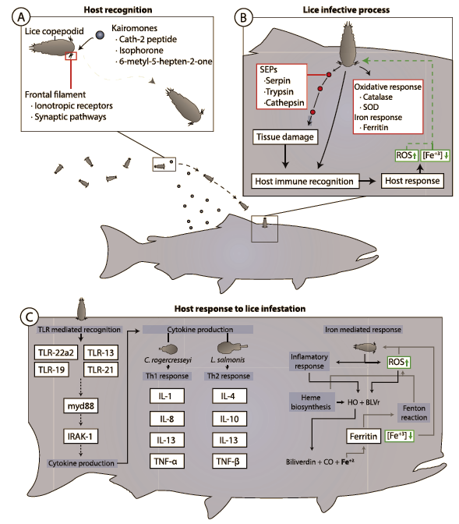
Sea lice – Salmon interaction

Slide 32
Sea lice – Salmon interaction
Generalized chronic stress response
Sea lice damage the attachment site (feed on skin, mucus, blood)
Secretes enzymes that degrade the mucus and help evade immune system
Changes in infested Salmon
Loss of epithelium
Bleeding
Increase in mucus secretion
Change in mucus composition
Tissue necrosis
Loss of skin as barrier
Increased expression of il10 and il4 (Th2 immune response) Valenzuela-Munoz et al 2016
Activation of the innate immune system (associated with tlr22a2 expression)
High expression of inflammatory and oxidative stress response genes (boltana, 2016)
Nutrition immune response
Reduce iron availability to the parasite (iron modulation and binding transcripts observed Valenzuela-munoz 2017)
438 lncRNAs modulated by C.rogercresseyi (Tarifeno-Saldivia 2017); 3678 lncRNAs modulated by C.rogercresseyi (Valenzuela=Munoz 2018)
Analysis of neighbor genes show lncRNAs may be involved in immune response in Atlantic salmon and in tissue repair in Coho

Slide 33
Environment influence on epigenome

Slide 34
Does the environment change the salmon response to sea lice?

Slide 35
Experimental set-up
8 fish/tank, 35 sea lice/fish, 4 tanks/treatment for 30 days
sea lice
no sea lice
Reduced-Representation
Bisulfite Sequencing
8°C
MspI +TaqαI digest
16°C
32 psu
26 psu
Notes:
add

Slide 36
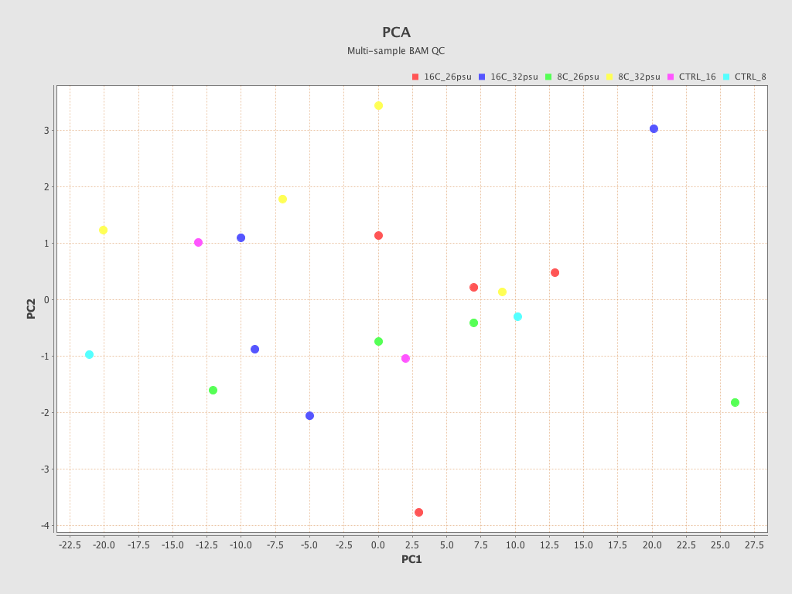
PCA of all RRBS data
Are these samples different?

Slide 37
DMR: Differentially methylated region
~250bp site
containing at least 3 CpGs that are significantly differentially methylated than expected from genetic origins of methylation variation
AND
with significantly different methylation across experimental groups (ANOVA)
Observed mCpG
Randomly shuffle data
Sample | # reads with mCpG | # reads with any CpG
16C_32psu_1 | 5 | 5
16C_32psu_2 | 12 | 100
16C_32psu_3 | 6 | 10
16C_32psu_4 | 30 | 50
8C_32psu_1 | 15 | 20
8C_26psu_3 | 11 | 15
CTRL_8C_26psu_1 | 0 | 21
CTRL_8C_26psu_2 | 5 | 60
CTRL_16C_26psu_1 | 0 | 0
Sample | # reads with mCpG | # reads with any CpG
16C_32psu_1
16C_32psu_2
16C_32psu_3
16C_32psu_4
8C_32psu_1
8C_26psu_3
CTRL_8C_26psu_1
CTRL_8C_26psu_2
CTRL_16C_26psu_1
Notes:
Filtered at 5x coverage within a sample and 3x coverage by individuals within a group

Slide 38
DMR: Differentially methylated region
A 10 - 300bp region containing at least 3 CpGs that are:
significantly differentially methylated from expected genetic origins of methylation variation
significantly differentially methylated across experimental groups
Blue = # mCpGs
Red = # CpGs
26 PSU
32 PSU
26 PSU
controls
(no sea lice)
Notes:
Filtered at 5x coverage within a sample and 3x coverage by individuals within a group

Slide 39
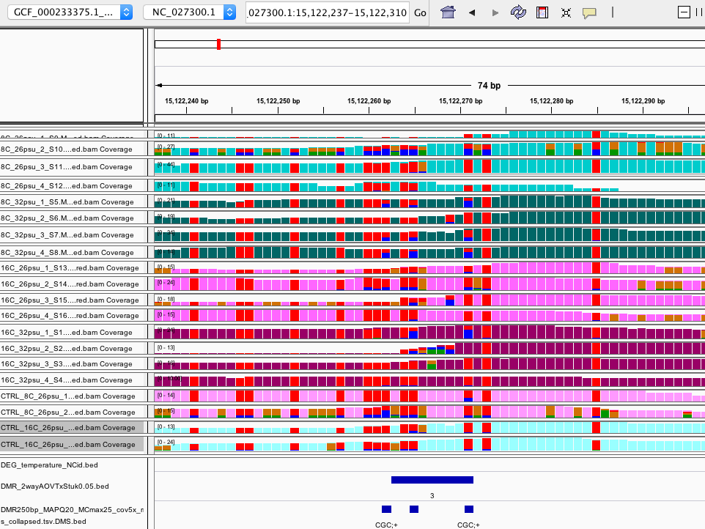
Example of DMR
Notes:
Don’t show unless bed graph. This is showing coverage/cpg (% methylation is the %blue or % orange)

Slide 40
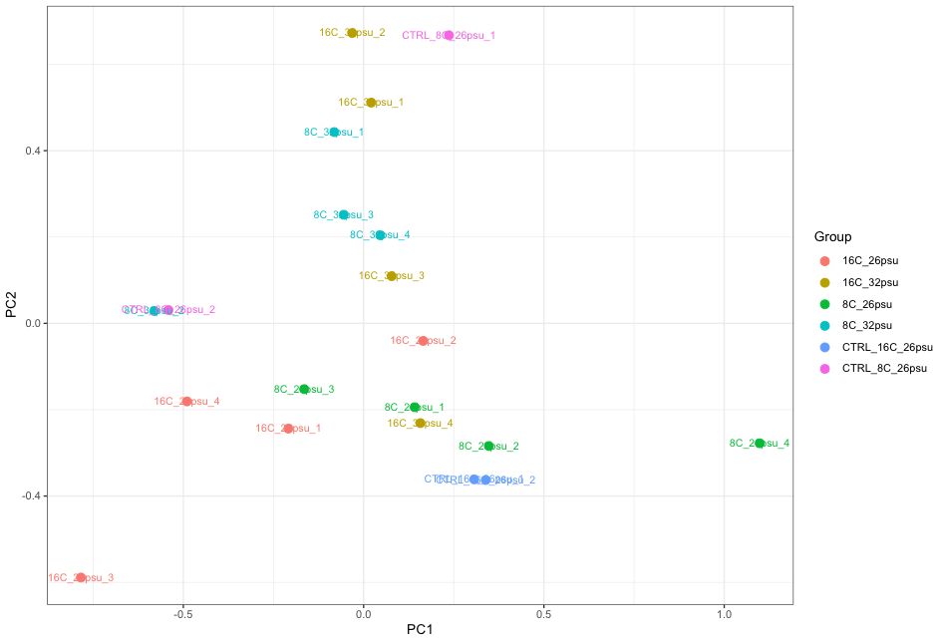
PCA of DMRs before group stats
In general salinity groups separate on PC2
Temperature groups separate on PC1 except
189 DMRs

Slide 41
Influence of temperature on methylation
Relative % methylation
SEA LICE
NO SEA LICE
8°C
26PSU
8°C
32PSU
16°C
26PSU
16°C
32PSU
8°C
26PSU
16°C
26PSU
Sea lice-dependent decrease in methylation under low temperature (8°C)
RENBP (intron), ion homeostasis
USP45 (intron), protein deubiquitylation
Notes:
First Intron methylation correlates with reduced gene expression: https://epigeneticsandchromatin.biomedcentral.com/articles/10.1186/s13072-018-0205-1 (agrin: https://www.sciencedirect.com/science/article/pii/S2211124719308022)

Slide 42
Influence of temperature on methylation
Relative % methylation
SEA LICE
NO SEA LICE
8°C
26PSU
8°C
32PSU
16°C
26PSU
16°C
32PSU
8°C
26PSU
16°C
26PSU
RARA (intron)
Intergenic (upstream ACYP2, unknown physiology)
Agrin-like (intron), inhibits NA/K channels, modulates growth (favors aggregation)
Intergenic (upstream Prop1 HOX, tissue development)
Intergenic
Unch. lncRNA
EGR1, zinc finger that regulates inflammatory response proteins, cell prolif.
Intergenic (upstream ANKHD1, antiapoptosis and cell survival)
Intergenic (upstream COPB1, immune secretory pathway)
Intergenic (upstream DPYSL3, cytoskeleton remodeling, injury response)
FAM189-A2
Notes:
First Intron methylation correlates with reduced gene expression: https://epigeneticsandchromatin.biomedcentral.com/articles/10.1186/s13072-018-0205-1 (agrin: https://www.sciencedirect.com/science/article/pii/S2211124719308022)

Slide 43
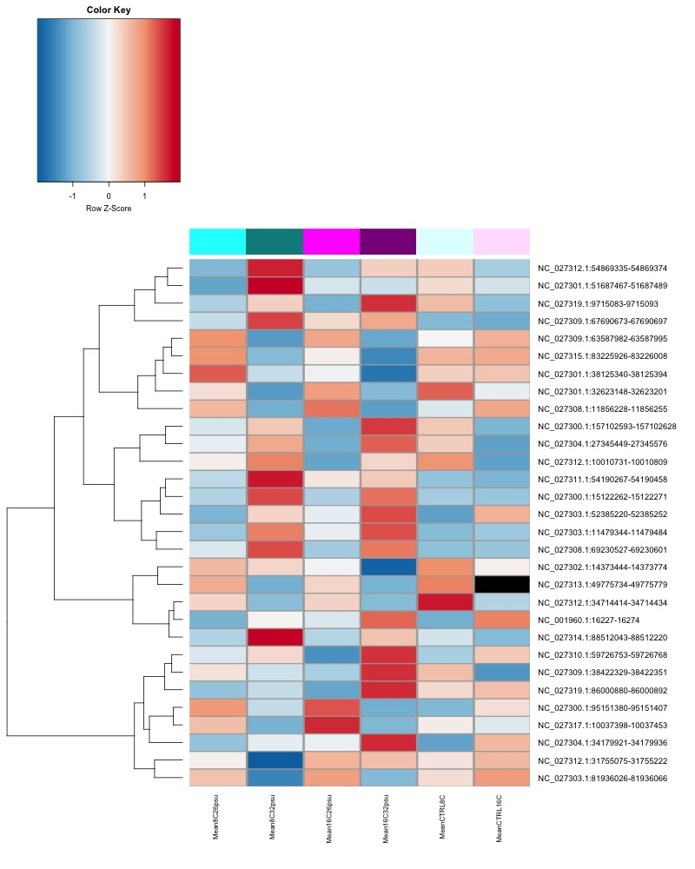
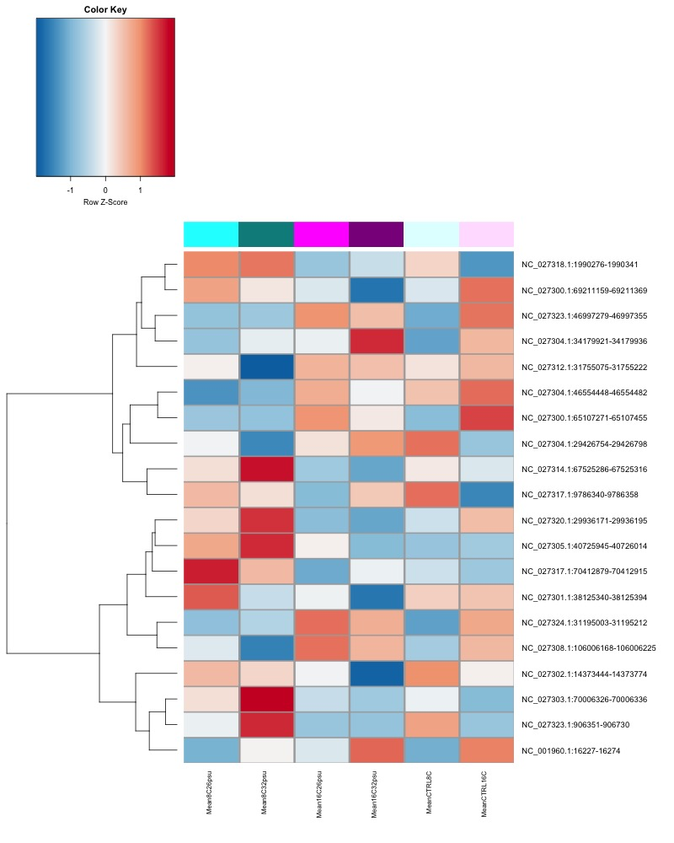
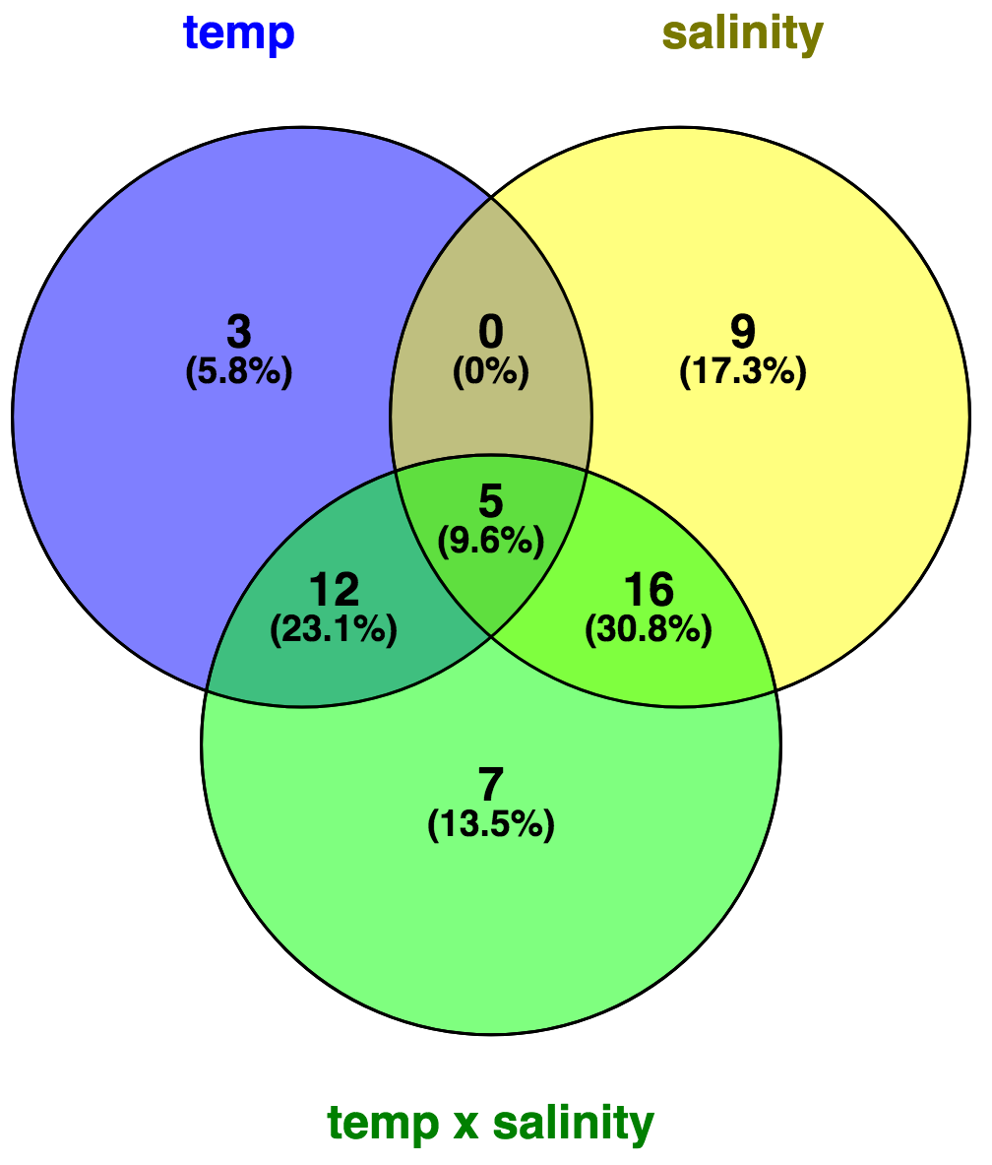
52 significant DMRs
30 DMRs with significant salinity effect
(2-way ANOVA p.adj < 0.05)
20 DMRs with significant temperature effect
(2-way ANOVA p.adj < 0.05)
Sea lice
No
sea lice
Sea lice
No
sea lice
Relative % methylation
Relative % methylation
8°C
26PSU
8°C
32PSU
16°C
26PSU
16°C
32PSU
8°C
26PSU
16°C
26PSU
8°C
26PSU
8°C
32PSU
16°C
26PSU
16°C
32PSU
8°C
26PSU
16°C
26PSU

Slide 45
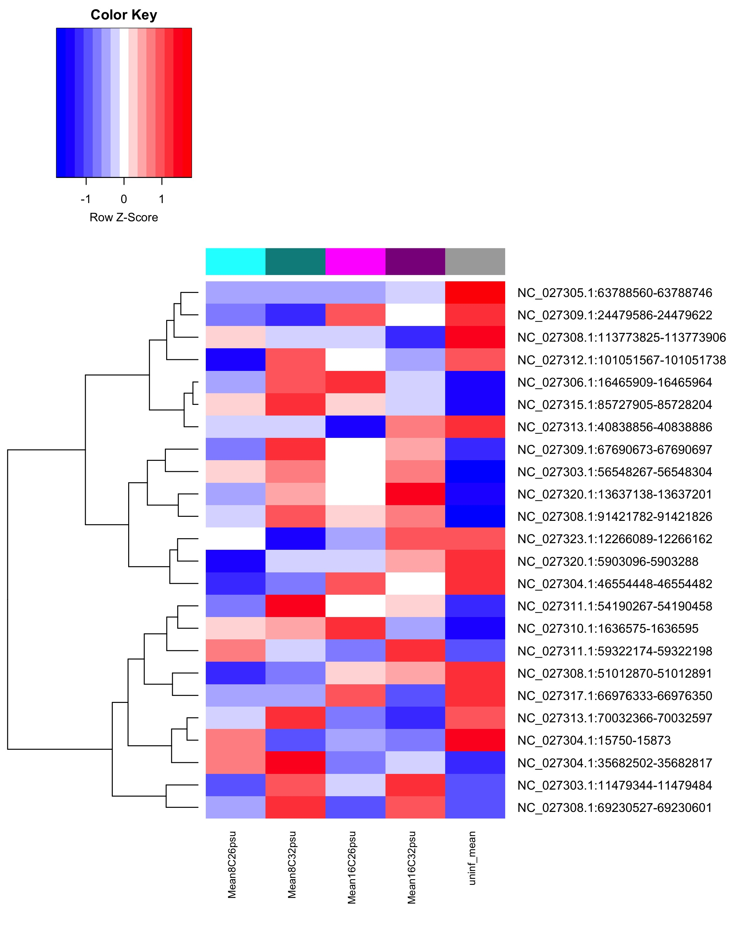
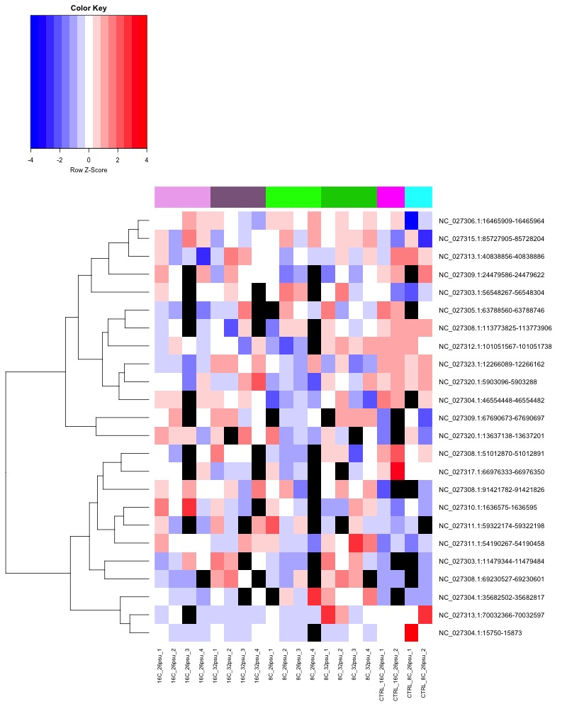
Heatmap of DMRs?
24 DMRs significant @ p < 0.1
1 way ANOVA, sea lice status
Sea lice
No
sea lice
Infested vs. not infested
8°C
26PSU
8°C
32PSU
16°C
26PSU
16°C
32PSU
Sea lice
No sea lice
8°C 26PSU
8°C 32PSU
16°C
26PSU
8°C
26PSU

Slide 46
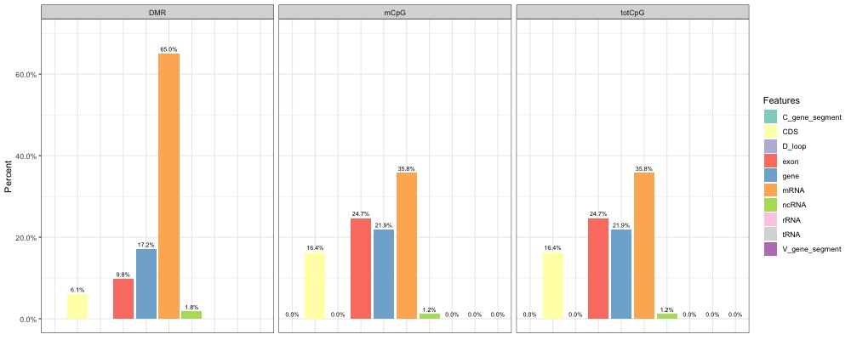
Where DMRs are
Overlap with genome features

Slide 47
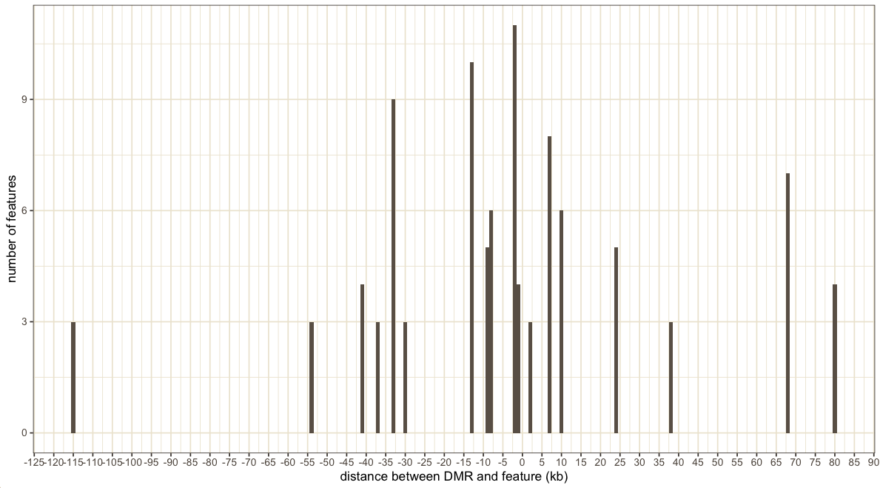
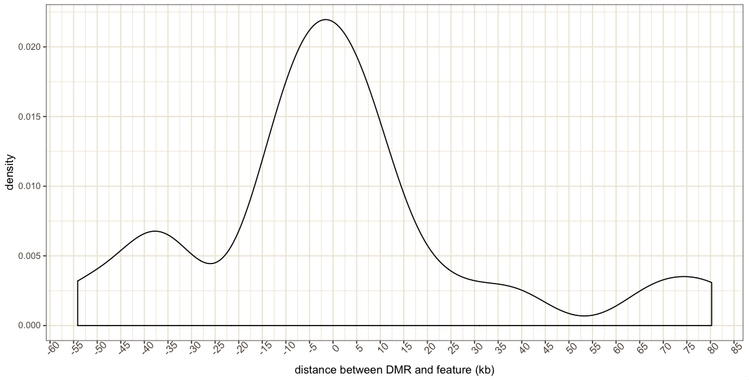
Where are DMRs that aren’t in features?
24/52 (46%) DMRs not overlapping with features
Closest features

Slide 48
Functions
Look at GO terms for +/- 2500bp closest features (including overlap)
temperature hypo
temperature hyper
Salinity hypo
Salinity hyper
Overlap with DEGs from Gustavo’s analysis

